Slide 1
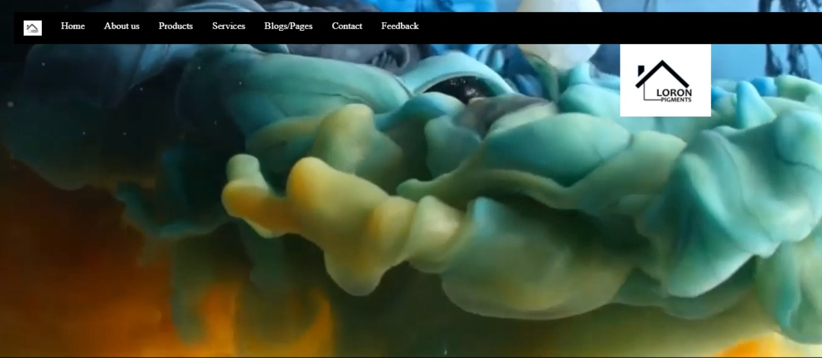
ICT Final Project
We planned to make a site of an organization named Loron Pigments which gives paints, primers and painters for homes. We guaranteed the best of our endeavors for making this venture and adhered to the guidelines given in the manual gave.

Slide 2

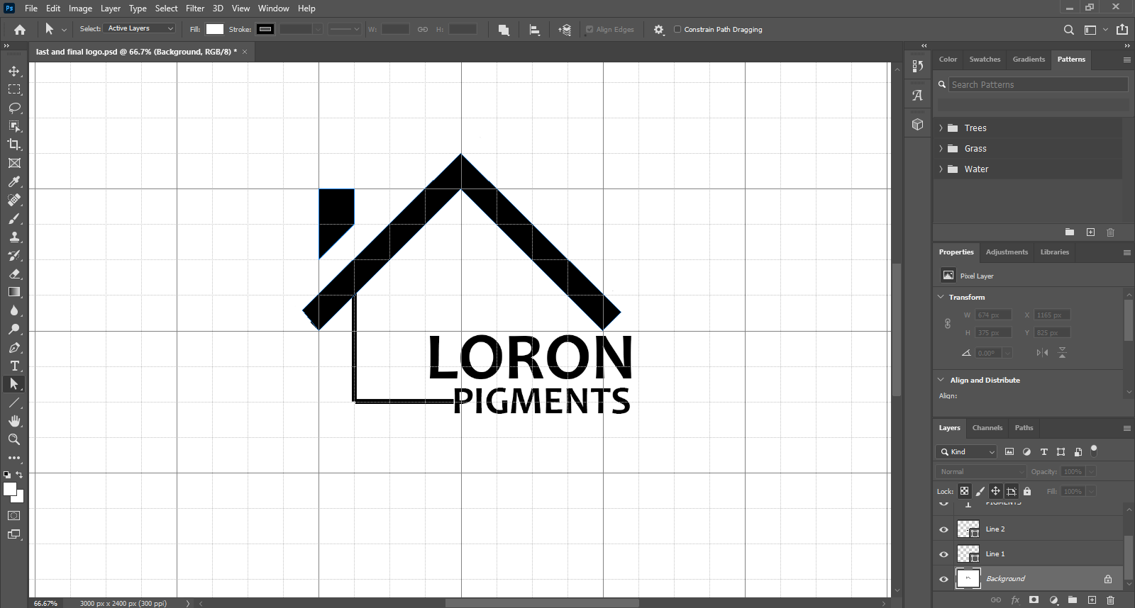
LOGO
We designed our logo utilizing adobe Photoshop (a notable programming for altering), and taking advantage from its tools including pen tool, path tool, textbox tool, grid view etc.
Logo with its structure represents a home and name pigment means color. Aggregately it speaks to the genuine point of organization which is to give paint and painters to homes

Slide 3

FLYER
With a similar software of logo we planned our flyer. An extraordinary plan is made utilizing shape tool, layers option, text box tool, and so on of Adobe Photoshop. Some of significant parts of organization are remembered for it alongside the important logo and some venture pictures of organization. A best given proposal by organization is likewise included the flyer so it can turn out to be more alluring and consideration looking for a client.

Slide 4
FEATURES OF WEBSITE
Website include some of these features:
HOME PAGE: As a main represented page of website.
ABOUT US: for adding information about company.
PRODUCTS: for displaying products of company to clients.
SERVICES: for showing company’s services to a customer visiting the website.
BLOGS/PAGES: for showing social media links of company.
CONTACT: for adding contacts of company and enabling customer to contact company for placing orders.
FEEDBACK: for having a feedback from clients about company’s services and goods.

